Slide 1
Introduction to Artificial Intelligence
Sir Syed University of Engineering & Technology, Karachi
Lecture # 1
Department of Computer Science & Information Technology

Slide 2
Course Description
Introduction to Artificial Intelligence (AI) history and applications
Intelligent Agents
Knowledge representation
Problem solving in artificial intelligence, searching and reasoning;
Searching techniques
Design & development of Expert Systems
Machine learning
Advanced AI Topics. ANN, Natural language processing, Computer vision, Fuzzy logic.
Generative AI.

Slide 3
Learning Outcomes
Understand the meaning of AI, its alternative approaches and the implications of AI for cognitive science more broadly.
Expand knowledge about searching techniques, genetic algorithm, planning, and learning algorithms.
Understand the basic methods in planning and reasoning using both logic and uncertain inference.
Know a variety of ways to represent and retrieve knowledge and information [Expert systems, Agents].
Know the fundamentals of AI programming techniques and advanced machine learning in a modern programming language.

Slide 4
Lecture Outline
Course overview
What is AI?
Foundations of AI
Areas & Applications of AI
A brief history of AI

Slide 5
About Theory Course
Course Code | CS- 325T
Course Title | Artificial Intelligence
Credit Hours | 3
Abbreviation | AI
Prerequisite | Programming Fundamentals
Type of Course | Core course

Slide 6
Course Assessment
Quizzes and Assignments | 20%
Midterm Examination | 30%
Final Examination | 50%
Total | 100%

Slide 7
Text & Reference Books
Text Book
Artificial Intelligence: A Modern Approach” by Struart Russel and Peter Norving, 4thEdition
Reference books
“Artificial Intellegence“ by George F Luger
“Fuzzy Logic with Engineering Application” by Timothy J.Ross

Slide 8
Top Technologies of AI
Natural Language Generation
Speech Recognition
Machine Learning Platforms
Virtual Agents
Decision Management
AI Optimized Hardware
Deep Learning Platforms
Robotic Process Automation
Text Analytics and Natural Language Processing (NLP)
Bio-metrics
Cyber Defense
Content Creation
Emotion Recognition
Image Recognition
Marketing Automation

Slide 9
Intelligence
Intelligence is a property of mind that encompasses many related mental abilities, such as the capabilities to
reason
plan
solve problems
think abstractly
Perception

Slide 10
Cont...
In 1950 Alan Turing published a paper in a conference with title
“Can Machines think”
We are still finding the answer of that question...

Slide 11
Evolution of Artificial Intelligence

Slide 12
What is Artificial Intelligence
Intelligence: “ability to learn, understand and think” (Oxford dictionary).
AI is the study of how to make computers make things which at present people do better.
Examples: Speech recognition, Smell, Face, Object, Intuition, Inferencing, Learning new skills, Decision making, Abstract thinking.

Slide 13
More Formal Definition of AI
AI is a branch of computer science which is concerned with the study and creation of computer systems that exhibit
some form of intelligence
OR
those characteristics which we associate with intelligence in human behavior.

Slide 14
What is Artificial Intelligence?
Thinking humanly | Thinking rationally
Acting humanly | Acting rationally

Slide 15
Acting Humanly: The Turing Test
Predicted that by 2000, a machine might have a 30% chance of fooling a lay person for 5 minutes.
Anticipated all major arguments against AI in following 50 years.
Suggested major components of AI: knowledge, reasoning, language, understanding, learning.

Slide 16
Acting Humanly: The Turing Test
The Turing Test, proposed by Alan Turing (Turing, 1950)
Turing defined intelligent behavior as the ability to achieve human-level performance in all cognitive tasks, sufficient to fool an interrogator.
Roughly speaking, the test he proposed is that the computer should be interrogated by a human via a teletype, and passes the test if the interrogator cannot tell if there is a computer or a human at the other end.

Slide 17
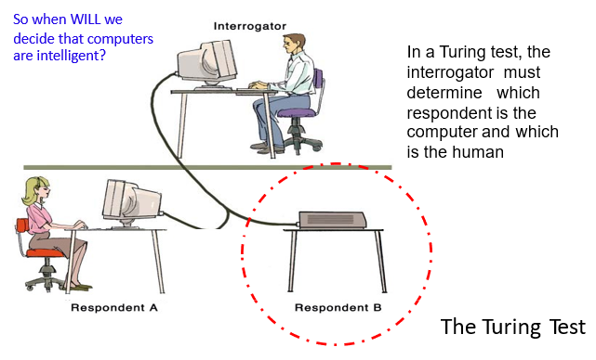
Systems that act like humans

Slide 18
Systems that act like humans
To pass the Turing test computer would need to possess the following capabilities:
natural language processing to enable it to communicate successfully in English (or some other human language);
knowledge representation to store information provided before or during the interrogation;
automated reasoning to use the stored information to answer questions and to draw new conclusions;
machine learning to adapt to new circumstances and to detect and extrapolate patterns.

Slide 19
Systems that act like humans
However ,the Turing test excludes direct physical contact between the machine and the interrogator. The so called the Total Turing test brings forward the following two requirements.
Robotics in order to move objects
Computer vision in order to perceive objects

Slide 20
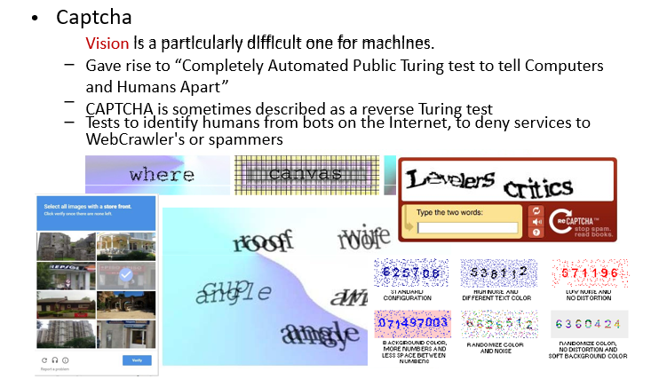
Systems that act like humans

Slide 21
Thinking Humanly
•This requires "getting inside" of the human mind to see how it works and then comparing our computer programs to this.
• There are (at least) two possible routes that humans use to find the answer to a question: – We reason about it to find the answer. This is called “introspection”. – We conduct experiments to find the answer, drawing upon scientific techniques to conduct controlled experiments and measure change.

Slide 22
Thinking Humanly: Cognitive Modelling
For example, Allen Newell and Herbert Simon in 1961, who developed GPS, the “General Problem Solver” was an early computer program that attempted to model human thinking (Newell and Simon,1961)
The developers were not so much interested in whether or not GPS solved problems correctly.
They were more interested in showing that it solved problems like people, going through the same steps and taking around the same amount of time to perform those steps..
This is what cognitive science attempts to do. Another way to do this is to observe a human problem solving and argue that one's programs go about problem solving in a similar way.

Slide 23
Thinking Rationally:The “laws of thought” approach
Aristotle was one of the first to attempt to codify "thinking".
Approach is to model how we should think.
This was the first step toward enabling computer programs to reason logically.
By 1965, programs existed that could, given enough time and memory, take a description of the problem in logical notation and find the solution, if one existed. The logicist tradition in AI hopes to build on such programs to create intelligence.

Slide 24
Thinking Rationally:The “laws of thought” approach
The “thinking rationally” approach to AI uses symbolic logic to capture the laws of rational thought as symbols that can be manipulated.
Reasoning involves manipulating the symbols according to well-defined rules, kind of like algebra.
for example,
“Socrates is a man; all men are mortal; therefore, Socrates is mortal.”
“All computers use energy. Using energy always generates heat. Therefore, all computers generate heat.”

Slide 25
Thinking Rationally:The “laws of thought” approach
There are two main obstacles to this approach:
First, it is difficult to make informal knowledge precise enough to use the logicist approach particularly when there is uncertainty in the knowledge.
Second, there is a big difference between being able to solve a problem in principle and doing so in practice.

Slide 26
Acting Rationally: The Rational Agent Approach
Acting so, as to achieve one’s goals, given one’s beliefs.
Does not necessarily involve thinking.
In the logical approach to AI, the emphasis is on correct inferences.
But this is not all of rationality because agents often find themselves in situations where there is no provably correct thing to do, yet they must do something.
There are also ways to act rationally that do not seem to involve inference, e.g., reflex actions.

Slide 27
Acting Rationally: The Rational Agent Approach
Advantages:
It is more general than the logical approach because correct inference is only a useful mechanism for achieving rationality, not a necessary one.
It is more amenable to scientific development than approaches based on human behaviour because a standard of rationality can be defined independent of humans.

Slide 28
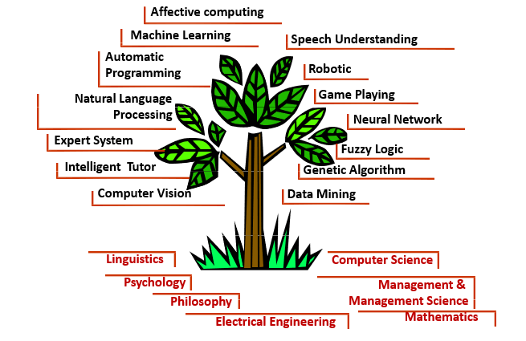
AI Tree

Slide 29
Types of AI
Reactive Artificial Intelligence
Theory of Mind AI
Limited Memory AI
Self-Aware AI

Slide 30
Reactive Artificial Intelligence
Machines and systems based on this type of AI neither have a concept of the past, historic data and inferences from it nor the ability to conceive a future.
Such machines work on the present, a scenario or a task that is right in front of them.
A popular example of a reactive AI machine is IBM's Deep Blue, a machine that beat chess Grandmaster Garry Kasparov in 1997. Spam filters, Netflix recommendation engine etc.

Slide 31
Theory of Mind AI
The theory of mind AI will focus mainly on emotional intelligence so that human thoughts and believes can be better comprehended. It is more on the books and science fiction movies.
Computers equipped with this kind of AI will be able to understand emotions, and they will be able to differentiate between various emotions of different people. This kind of AI is a work-in-progress.
A humanoid robot Sophia can come in this type.

Slide 32
Limited Memory AI
The memory in such systems is short lived.
Such systems can go back to their past for a short time and learn from it.
Self-driving cars are one of the best examples of Limited Memory systems. These cars can store recent speed of nearby cars, the distance of other cars, speed limit, and other information to navigate the road.

Slide 33
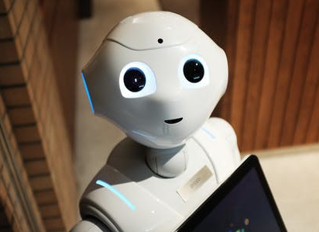
Self-Aware AI
Self-aware artificial intelligence is an extension of the Theory of Mind class of artificial intelligence.
In this type of artificial intelligence, machines or robots have their own consciousness and are aware of who they are, understand their internal traits, states and conditions and even perceive human emotions.
Does not exist yet.

Slide 34
Stages of AI
Artificial Narrow Intelligence (ANI)
Artificial General Intelligence (AGI)
Artificial Super Intelligence (ASI)

Slide 35
Artificial Narrow Intelligence (ANI)
The first stage ANI, is also called weak AI is for example, on par with an infant.
As the name suggests, is limited in scope with intelligence restricted to only one functional area.
ANI is the thinking focused towards the development of technology capable of carrying out pre-planned moves based on some rules and applying these to achieve a certain goal.
The principle behind Weak AI is simply the fact that machines can be made to act as if they are intelligent.
IBM's Watson supercomputer, expert systems and the self-driving car are all examples of weak or narrow AI.

Slide 36
Artificial General Intelligence (AGI)
The second stage AGI is also called Strong AI.
It covers more than one field like power of reasoning, problem solving and abstract thinking, which is mostly on par with adults.
The principle behind Strong AI is that the machines could be made to think or in other words could represent human minds in the future. If that is the case, machines will have the ability to reason, think and do all functions that a human can do.
But according to most people, this technology will never be developed or at least it will take a very long time.

Slide 37
Artificial Super Intelligence (ASI)
ASI is the final stage of the intelligence explosion, in which AI surpasses human intelligence across all fields.
Presently seen as hypothetical situation as depicted in movies and science fiction books where machines will take over the world.
However tech masterminds like Elon musk believes that ASI will take over the world by the year 2040.

Slide 38
Foundations of AI
AI is a young field. It has inherited its ideas, concepts and techniques from many disciplines which are considered as the foundations of AI.
Philosophy: Logic, methods of reasoning, mind as physical system, foundations of learning, language, rationality.
Mathematics: From mathematics we have formal theories of logic, probability, decision-making and computation.
Psychology: Tools and techniques to investigate the human mind and ways to represent the resulting theories based on psychology.
•Economics: Utility, decision theory, rational economic agents

Slide 39
Cont...
Linguistics: Linguistics provides us with the theories of structure and meaning of language.
Biology: From biology we have information about the network structure of a human brain and all the theories on functionalities of different human organs.
Control theory: Purposeful behaviour arising from a regulatory mechanism to minimize the difference between goal state and current state (“error”)
Computer Science: Finally from computer science we have tools and concepts to make AI a reality.

Slide 40
Goals of AI
To Create Expert Systems − The systems which exhibit intelligent behavior, learn, demonstrate, explain, and advice its users.
To Implement Human Intelligence in Machines − Creating systems that understand, think, learn, and behave like humans.

Slide 41
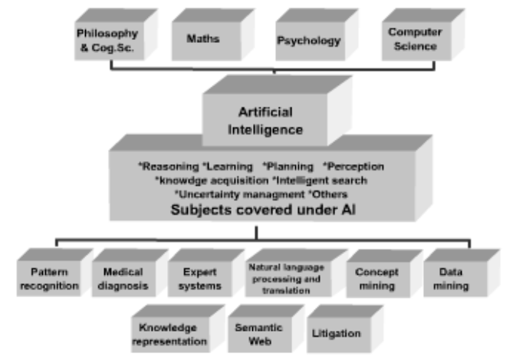
Areas of AI

Slide 42
Areas & Applications of AI
Gaming − AI plays crucial role in strategic games such as chess, poker, tic-tac-toe, etc
Natural Language Processing − It is possible to interact with the computer that understands natural language spoken by humans.
Expert Systems − There are some applications which integrate machine, software, and special information to impart reasoning and advising. They provide explanation and advice to the users.
Vision Systems − These systems understand, interpret, and comprehend visual input on the computer. For example,
A spying aero plane takes photographs, which are used to figure out spatial information or map of the areas.

Slide 43
Cont...
Speech Recognition − Some intelligent systems are capable of hearing and comprehending the language in terms of sentences and their meanings while a human talks to it.
Handwriting Recognition − The handwriting recognition software reads the text written on paper by a pen or on screen by a stylus.
Intelligent Robots − Robots are able to perform the tasks given by a human.

Slide 44

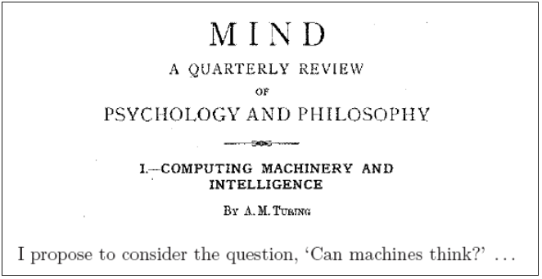
History & Evolution of AI
The history of AI begins with the following articles:
-Turing, A.M. (1950), Computing machinery and intelligence, Mind, Vol. 59, pp. 433-460.

Slide 45
Brief History of AI
The birth of artificial intelligence
-1950: Turing’s landmark paper “Computing machinery and intelligence” and Turing Test
-1951: AI programs were developed at Manchester:
A draughts-playing program by Christopher Strachey
A chess-playing program by Dietrich Prinz
These ran on the Ferranti Mark I in 1951.

Slide 46
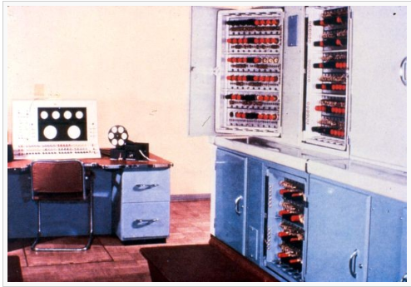
Ferranti Mark I

Slide 47
Cont...
-1955: Symbolic reasoning and the Logic Theorist
Allen Newell and (future Nobel Laureate) Herbert Simon created the
"Logic Theorist". The program would eventually prove 38 of the first
52 theorems in Russell and Whitehead's Principia Mathematica.
-1956: Dartmouth Conference - "Artificial Intelligence" adopted
The term ‘Artificial Intelligence’ was coined in a proposal for the conference at Dartmouth College in 1956 by John McCarthy .

Slide 48
Brief history of AI - Golden years 1956-74
Research:
-Reasoning as search: Newell and Simon developed a program called the
"General Problem Solver".
- it could find solutions to a wide range of fairly structured problems, such as logical proofs and mathematical word problems.
-Lisp: John McCarthy (MIT) invented the Lisp language in 1960.

Slide 49
Brief history of AI - Golden years 1956-74
Funding for AI research:
-Significant funding from both USA and UK governments
The optimism:
-1965, Simon: "machines will be capable, within twenty years, of doing any work a man can do
-1970, Minsky: "In from three to eight years we will have a machine with the general intelligence of an average human being."

Slide 50
The first AI winter
The first AI winter 1974−1980:
-Problems
Limited computer power: There was not enough memory or processing speed to accomplish anything truly useful.
Intractability and the combinatorial explosion. In 1972 Richard Karp showed there are many problems that can probably only be solved in exponential time (in the size of the inputs).
Commonsense knowledge and reasoning. Many important applications like vision or natural language require simply enormous amounts of information about the world and handling uncertainty.

Slide 51
The first AI winter
Critiques from across campus:
Several philosophers had strong objections to the claims being made by AI
researchers and the promised results failed to materialize
The end of funding:
The agencies which funded AI research became frustrated with the lack of
progress and eventually cut off most funding for AI research.

Slide 52
Brief history of AI -Boom 1980–1987
Boom 1980–1987:
-In the 1980s a form of AI program called "expert systems" was adopted by corporations around the world and knowledge representation became the focus of mainstream AI research
The power of expert systems came from the expert knowledge using rules that are derived from the domain experts.
In 1980, an expert system called XCON was completed for the Digital Equipment Corporation. It was an enormous success: it was saving the company 40 million dollars annually by 1986.
By 1985 the market for AI had reached over a billion dollars.

Slide 53
Cont...
-The money returns: the fifth generation project.
Japan aggressively funded AI within its fifth generation computer project (but based on another AI programming language - Prolog created by Colmerauer in 1972).
This inspired the U.S and UK governments to restore funding for AI research.
The expert systems are based a more flexibly interpreted version of the ‘rule- based’ approach for knowledge representation to replace the logic representation and reasoning

Slide 54
Brief history of AI - the second AI winter
The second AI winter 1987−1993
-In 1987, the Lisp Machine market was collapsed, as desktop computers from Apple and IBM had been steadily gaining speed and power and in 1987 they became more powerful than the more expensive Lisp machines made by Symbolics and others.
-Eventually the earliest successful expert systems, such as XCON, proved too expensive to maintain, due to difficult to update and unable to learn.

Slide 55
Brief history of AI - the second AI winter
-In the late 80s and early 90s, funding for AI has been deeply cut due to the limitations of the expert systems and the expectations for Japan’s Fifth Generation Project not being met
-Nouvelle AI: But in the late 80s, a completely new approach to AI, based on robotics, has bee proposed by Brooks in his paper "Elephants Don’t Play Chess”, based on the belief that, to show real intelligence, a machine needs to have a body — it needs to perceive, move, survive and deal with the world.

Slide 56
Becoming an Industry
One of the early research in AI is search problem such as for game-playing. Game-playing can be usefully viewed as a search problem in a space defined by a fixed set of rules
The real success of AI in game-playing was achieved in 1996 IBM Deep Blue beat Gary Kasparov for the first time.
1997 an upgraded version won an entire match against the same opponent.

Slide 57
Cont…
SIRI has been developed in 2011 .
In 2012, a team at Google created a neural network that learns to recognize cats from pictures. The model built using un-supervised Deep Learning, was exposed to over 10 million images for 3 days.

Slide 58
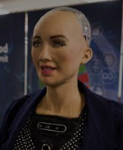
Cont…
Sophia is a social humanoid robot developed by Hong Kong-based company Hanson Robotics. Sophia was activated on February 14, 2016, and made her first public appearance at South by Southwest Festival (SXSW) in mid-March 2016 in Austin, Texas, United States.

Slide 59
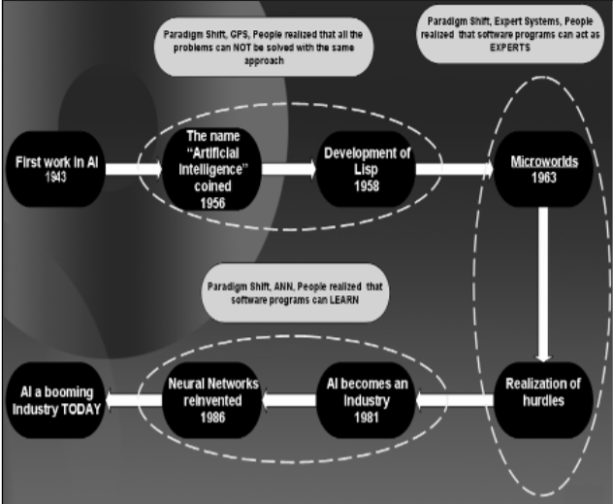
Diagram summarizes the history and evolution of AI in a comprehensive shape.

Slide 60
End Lecture Assignments
Turing’s paper on AI
You can get this article for yourself: go to
http://www.library.manchester.ac.uk/eresources/
select ‘Electronic Journals’ and find the journal Mind. The reference is:
-A. M. Turing, “Computing Machinery and Intelligence”, Mind, (New Series), Vol. 59, No. 236, 1950, pp. 433-460.
-You should read (and make notes on) this article in advance for your next class.
-Differentiate between human intelligence and artificial intelligence. Write down the pros and cons of both.

Slide 61
END OF LECTURE # 1

